Slide 1
RUSNAC E-SHOP Project Pitch
Cristin Rusnac

Slide 2
Project Description
‘RUSNAC E-SHOP’ is meant to be a clothing web shopping platform on which different brands will be offered.
It may start just like ‘Amazon’ and then grow to a marketplace where all willing clothing brands can place their products and have a similar concept to ‘StockX’.
Any product at first will be added and handled by the administration as well as the orders. Anyone will be able to view the available products, the clients that will want to make a purchase will have to signup and then add the wanted products to the basket after which they can precede with the payment and complete the order.
As the app will grow it will scale into a platform on which the possibility to add new products will be extended from administration to any willing clothing brand.

Slide 3
Challenges
Every feature of the app will be divided into microservices For example, there will be a microservice that will be responsible for authentication and authorization, a microservice for products publishing, a microservice for ordering, etc.
All the microservices will be independent and will work autonomously so if for example the microservice responsible for products publish fails the authorization and purchase ones will still be working.
The communication among microservices will be ensured through the Async Communication concept through the so called ‘Event Bus’.
The autonomy of each microservice will ensure that the app can be extended to any needed scale without interfering with already existing features

Slide 4
Technology selection
Node.js & Express
React & Next JS
MongoDB or Postgres
Deployment on Docker executed in Kubernetes

Slide 5
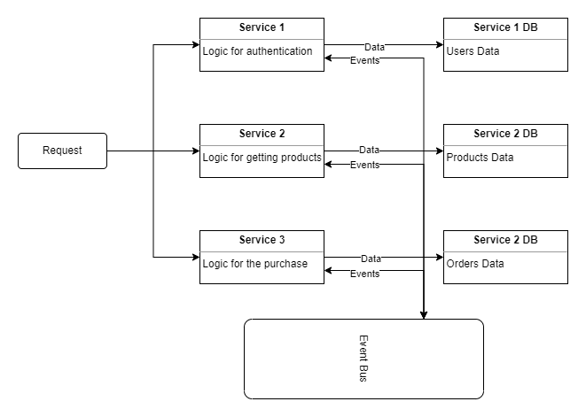
Logic Overview

